Slide 1



Connect 4 DOTS.
Monish Ramchandani 211ADB054
Manuga Rupatunge 211ADB076
K G Senuri N D Perera 211ADB084

Slide 2
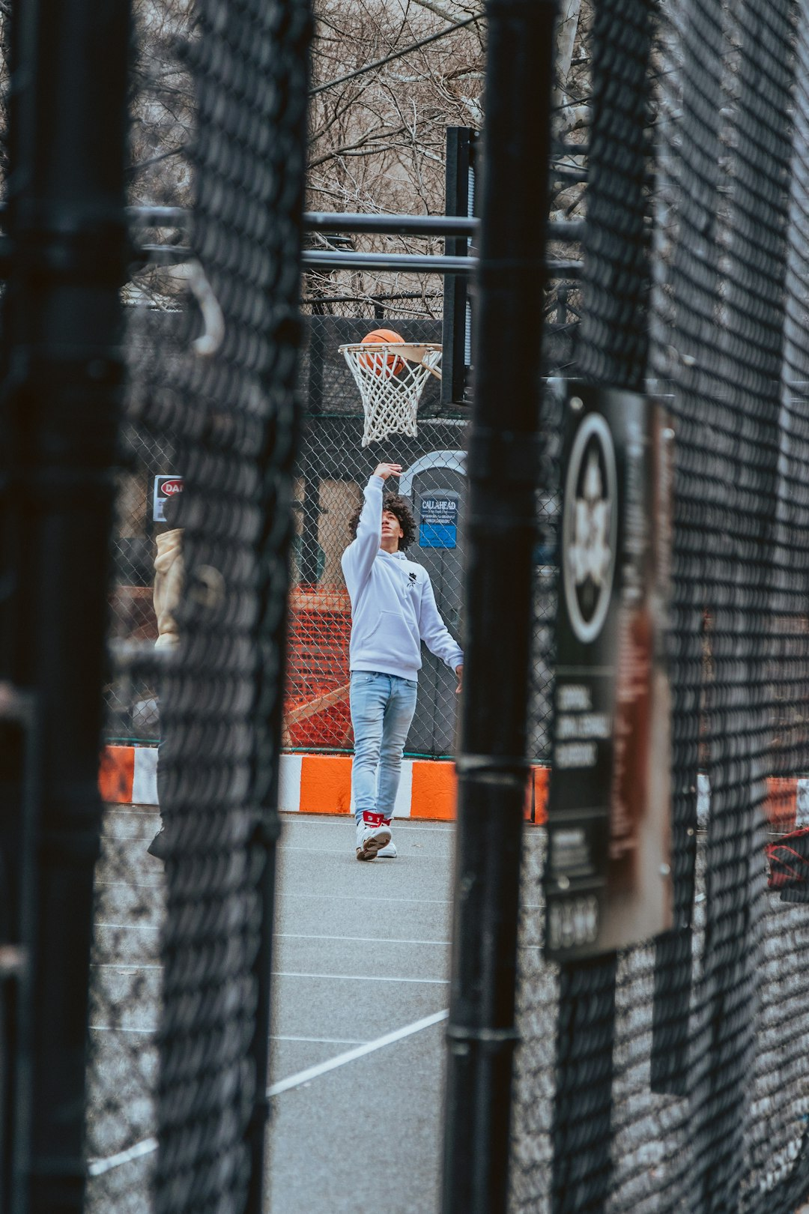
Game description.
Web-based version brings the classic Connect 4 experience to your browser.​ Connect 4 is a classic two player game which the players to be first to connect 4 similar color discs horizontally, vertically and diagonally.
With every new game their will be different background for that we used the Unsplash Api for generating the random background picture related to sports which involves strategy.
​Gameplay - Players turns round by dropping colors in a 6x 7 which contains 42 slots.
​
27 MAY 2024
PRESENTER NAME

Slide 3
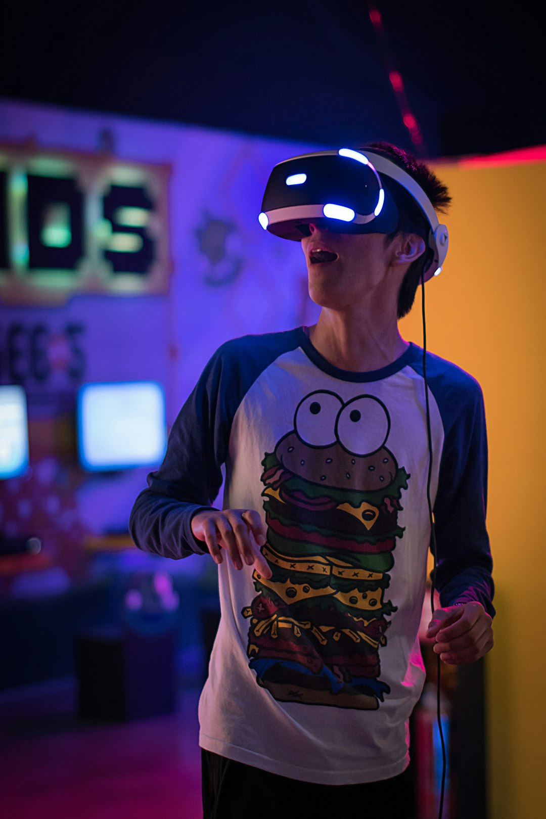
Game Rules
Players alternate turns, placing one dot per turn.
A dot must be placed in the lowest available position within the chosen column.
If a player places a dot that creates a line of four of their dots (horizontally, vertically, or diagonally), that player wins.
If the grid is completely filled without any player forming a line of four dots, the game is a draw.
27 MAY 2024
PRESENTER NAME

Slide 4
Software Requirements I
Initialise the game- Starting the game with 6*7 Grid
Mechanism of the game -
(i) Allow to place 1 disc at a time by clicking on the tile.
(ii) Players should get alternate moves.
Win Conditions- System should check horizontally, vertically and diagonally after each move.
User interface-
(i) Different colour disc for both players.
(ii) Restart button to reset the game.
(iii) Game board with clickable tiles.
Announce Winner- Announce the player who won the game.
Browser compatibility- Game can be played on browser.
​
27 MAY 2024

Slide 5
Testing Methods
Unit Testing:
To test individual functions and ensure they work as expected.
Integration Testing:
To test how different components of the game work together.
​
27 MAY 2024
PRESENTER NAME

Slide 6
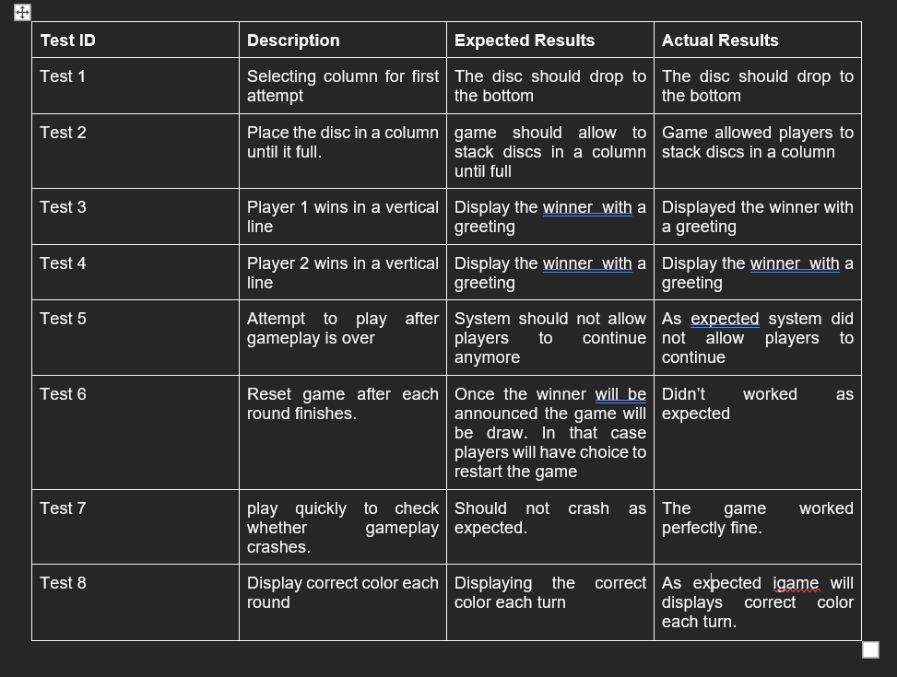
Tests I

Slide 7
Testing I
Following Tests done mentioned with TEST ID
Unit Testing:
Test-1 (Selecting column for first time)
Test-2 (Place disc until its full)
Test-8 (Correct colour each time)
Integration Testing:
Test-3(Player 1 and 2 wins vertically)
Test-4(Player 1 and 2 wins Horizontally)
Test-6( Refresh button )
​
27 MAY 2024
PRESENTER NAME

Slide 8
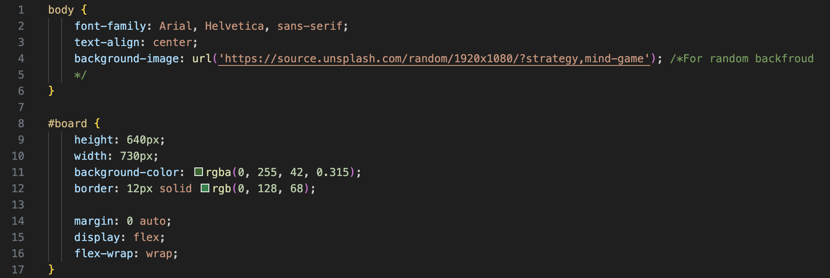
Code breakdown
Board and body
It's to design the board and for random background we used Unsplash API
27 MAY 2024
PRESENTER NAME

Slide 9
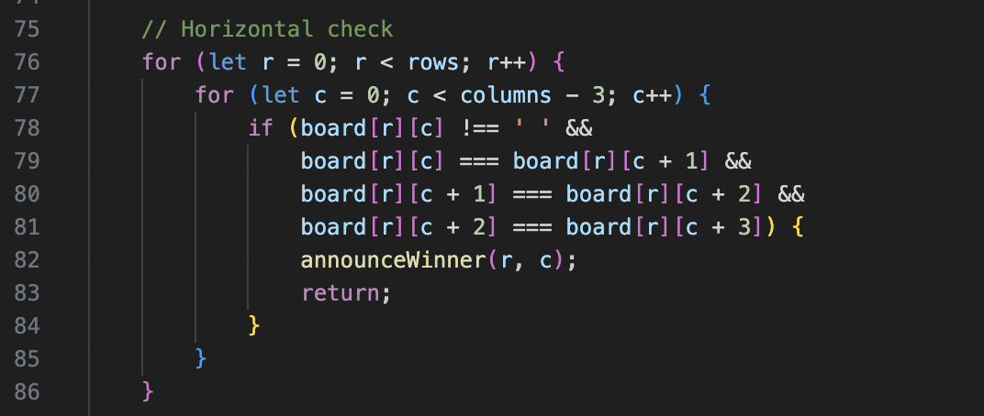
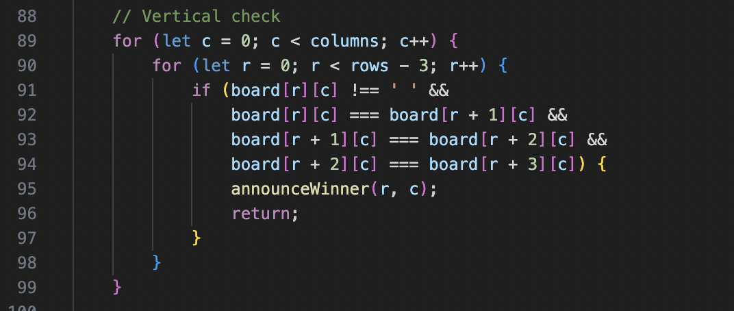
Implementing game logic through JavaScript functions
Horizontal win check
Vertical win check
27 MAY 2024
PRESENTER NAME

Slide 10
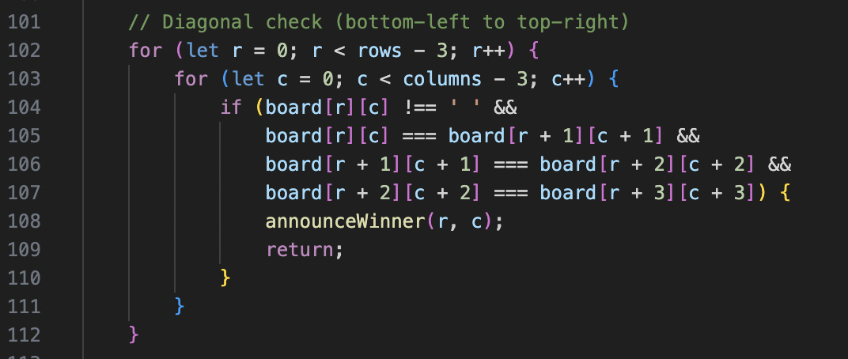
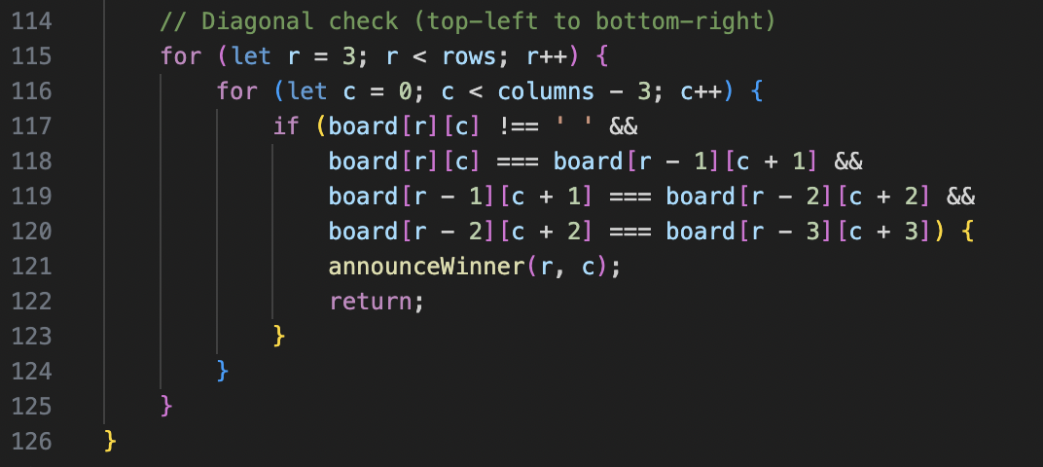
Implementing game logic through JavaScript functions
Diagonal win check (bottom-left to top-right)
Diagonal win check (top-left to bottom-right)
27 MAY 2024
PRESENTER NAME

Slide 11

Demonstration of the interactive Connect 4 gameplay
27 MAY 2024
PRESENTER NAME

Slide 12
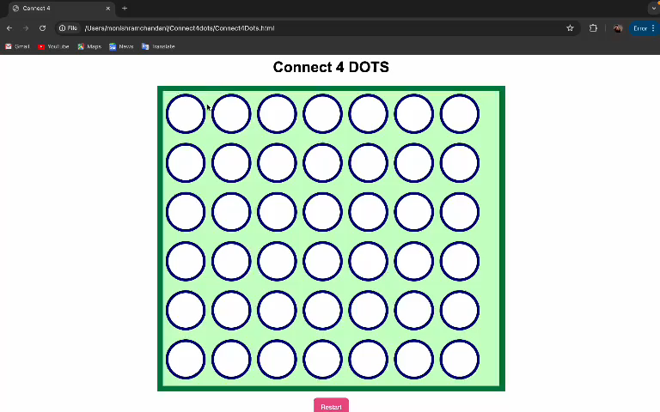
A PICTURE MAY BE WORTH 1,000 WORDS, BUT A CAPTION IS THE CHERRY ON TOP.

Slide 13
Thank you

Slide 14
